Slide 1
TIME COMPLIANCE TECHNICAL ORDER SUPPLY DATA REQUIREMENTS
AFTO FORM 874
EXAMPLE EXAMPLE

Slide 2
AFTO FORM 874
How to fill out form
Definitions and Responsibilities
What is an 874
How to fill out the form

Slide 3
AFTO FORM 874
What is an AFTO Form 874
The AFTO Form 874, Time Compliance Technical Order Supply Data Requirements (Figure 3-4 of 00-5-15), is used as an assembly document for all supply information required to ensure TCTO/TCTO Kits are available before the TCTO is released.
The PMA must complete approval and processing of the form within 30 days of receipt from the contractor or other preparing activity.
Requirements personnel must coordinate on the form if supply actions are required.
The original signed copy of the form will be retained by the PMA as part of the history file of the modification for the life cycle of the system or commodity affected.
Once the contract for the TCTO is signed, the contractor will complete an AFTO Form 874 (if kits or special tools are required) according to Paragraph 3.11 based on data in the AFTO Form 873 and forward the forms to the PMA for coordination and kit approval.

Slide 4
AFTO FORM 874
When development of the TCTO has progressed to the point where the parts affected and kit requirements can be determined, the TCM preparing the TCTO initiates an AFTO Form 874 (Paragraph 3.11 of the 00-5-15).
The AFTO Form 874 is required when TCTO kits or special tools/test equipment are required, when spares are impacted, and/or when parts are added or removed.
An AFTO Form 874 is not required for inspection TCTOs unless required consumables, special tools, etc., are not commonly available at the performing units.
If the AFTO Form 874 is not required, it is not necessary to include it in the six-part TCTO documentation folder.
After completion of the AFTO Form 874 (when required), the TCM prepares the body of the TCTO IAW MIL-DTL-38804D.
NOTE
If a TCTO requiring kits/special tools/test equipment must be released as an ITCTO, it may be processed and released prior to completion and approval of the AFTO Form 874.
However, the TCM must obtain coordination and approval of the supply information in the draft ITCTO before it is released.

Slide 5
AFTO FORM 874
NOTE
If a TCTO requiring kits/special tools/test equipment must be released as an ITCTO, it may be processed and released prior to completion and approval of the AFTO Form 874.
However, the TCM must obtain coordination and approval of the supply information in the draft ITCTO before it is released.

Slide 6
AFTO FORM 874
PRODUCTION MANAGEMENT ACTIVITY (PMA)
The program office (e.g. TCM/ES, Engineer, TO Manager, Production Management Specialist) that has responsibility for the acquisition and/or sustainment of a weapon system or commodity.
PROGRAM MANAGER (PM) – As per TO-00-5-15 (3.5.3.3.1 through 3.5.3.3.3)
The PM will assign the item manager (Supply Planner as well) for the end-item.
Receiving the AFTO Form 874 from the PMA.
Assign any additional individual responsibilities and accomplish the coordination of TCTO supply data from affected individual component/piece/part manager.
Annotate any relevant supply requirements on the AFTO Form 874, obtain kit manager’s signature in the block marked Kit Manager, and return to the PMA
Notes:
The responsible PMA performs the following management functions:
-Purchase Request preparations for, or initiating action to assemble related kits.
-Ensures TCTO’s are verified in accordance with TO-00-5-15
-Ensures completion of AFTO form 82 and is maintained in the TCTO file.
-Maintains kit delivery and distribution schedules.
-Ensures logistics support is available with the release of the TCTO and kits.
-Manages accomplishments of the TCTO or modification to the affected weapon systems, commodity, and affected spares as required, and tracking TCTO compliance.
-Rescinds TCTO or extends recission dates as necessary.
-Initiates request for proper disposition action on any excess kits.
-Ensures computer programs have been prepared by the responsible computer resources activity and sufficient quantities are available for concurrent distribution with the TCTO and any applicable TO updates.
-Responsible to review and correct TCTO status change errors on the REMIS Suspense File Error Correction section.

Slide 7
AFTO FORM 874
TECHNICAL CONTENT MANAGER (TCM)/Equipment Specialist (ES) — The individual responsible for
Organically Prepared
Submit the AFTO Form 874 for coordination of any supply actions
Notify individual IM and DLA responsible for items affected by the TCTO of potential impacts on assigned equipment.
Review the completed form upon return from requirements section and submit to PMA.
Contractor Prepared
Review AFTO Form 874 within 7 days after receipt from the PMA to determine kit requirements and critical items. (As used, pertains to parts which could cause de-modification or create hazardous conditions if re-installed on modified equipment.)
Ensure the contractor has listed the NSNs for all stock listed items and the manufacturer part numbers and CAGE codes for non-stock listed items on the AFTO Form 874.
Include any items which will require re-identification after modification. Contact will be made with the PMA to obtain any missing information, and ensure the contractor as calculated the number of kits required for installs and spares (item in stock affected by the modification or inspection).

Slide 8
AFTO FORM 874
EQUIPMENT SPECIALIST (ES)
The individual or position responsible for assisting the acquisition team during the development/production phase and for technical management of a system, subsystem or commodity during the sustainment phase of a program.

Slide 9
AFTO FORM 874 Heading Information
How to fill out the form
Block 1 - Return To: The activity preparing the TCTO (TCM/ES or contractor return address).
Block 2 – Date: Form preparation date or (if contractor-prepared) date submitted to the government. (YYYY-MM-DD)
Block 3 - Date First Kit Must Be Available: Determined by PM/LMS based on modification program requirements. (YYYY-MM-DD)
Block 4 - TCTO Number: Obtain from the AFTO Form 873 or TO Manager (TOMA).
Block 5 - Data Code Number: Obtain from the AFTO Form 873 or TO Manager.
Block 6 - TCTO Title and Application: Obtain from the AFTO 873
Block 7 - Kit Assembly: Check the appropriate box from the following choices; Contractor, Depot or DLA.

Slide 10
AFTO FORM 874 PART A
Block 1 – Kits to be furnished by requisition from: Obtain from owning agency.
Block 1a – Number of Kits required: Enter the number of kits being acquired.
Block 1b – Required materials requisitioned from appropriate agency: Enter the agency from where the required materials will be obtained from.
Block 1c – Delivery of Kits/parts is scheduled to begin about_________and be completed by________: Enter the dates from the dropdown calendar that the scheduled delivery of kits/parts are expected to begin, and when the deliveries are to be completed.
Block 2 – Kit information and components. List all items required for the modification: List all required kit information in the applicable column. List kit information on 1st line with components on subsequent. List the assigned NSN of the item being modified or inspected or the computer program identification number (CPIN) of the software being distributed. If an NSN has not been assigned, enter the stock class followed by the manufacturer part number, nomenclature, and CAGE (Commercial and Government entity code). List the applicable code from the choices listed (if applicable).

Slide 11
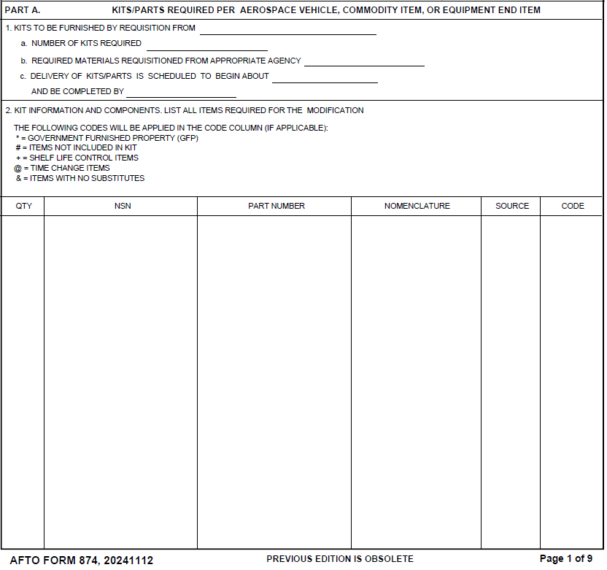
AFTO FORM 874 PART A

Slide 12
AFTO FORM 874 Part B - Action Required On Spares
Block 1 – Spares to be modified: Check the applicable box “YES” or “NO”. If yes, indicate action required in Action column with reference to the applicable phrase 1a through 1e.
Block 2 – War Reserve Material to be modified: Check the application box “YES” or “NO”.
Block 2a – War Reserve Material Stocks in storage site(s): Enter where the items are to be shipped to and check the applicable box for Rework, Salvage, Reclamation, or any other applicable action.
Block 3 – Modified Locally: Check the application box “YES” or “NO” if local modification is to be performed. If yes, perform the tasks listed in 3a through 3e. In item 3c, select the disposal date from the dropdown calendar. If 3e is utilized, enter any other action to be taken.
Block 4 – All Spares Information: List all required spare information in the applicable column. Codes from Part A, Block 2 will be utilized in the Code column.

Slide 13
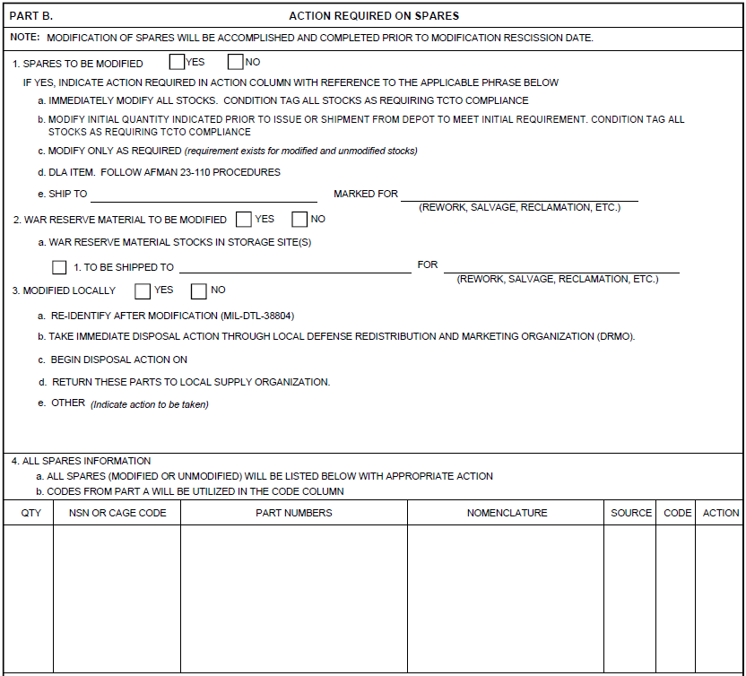
AFTO FORM 874 Part B - Action Required On Spares

Slide 14
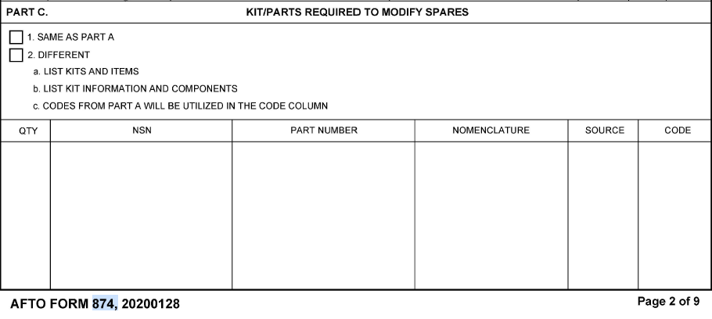
AFTO FORM 874 Part C - Kits/Parts Required To Modify Spares
Block 1 – Same as Part A: Check the box if parts are the same as those indicated in Part A.
Block 2 – Different: Check the box if the parts are different than those indicated in Part A. If this box is checked, list all required kit information in the applicable column. List kit information on 1st line with components on subsequent. Codes from Part A, Block 2 will be utilized in the Code column.

Slide 15
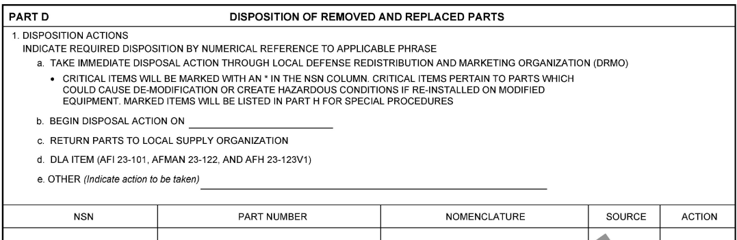
AFTO FORM 874 Part D - Disposition of Removed and Replaced Parts
Block 1 – Disposition Actions: List all required part information in the applicable column. Indicate action required in Action column with reference to the applicable phrase in 1a through 1e. For item 1a, these parts will be returned to DRMO with instruction for disposition of removed and replaced parts. All items critical to flight safety, or will cause de-modification if reinstalled on modified equipment, will be coded as such. Instructions must be provided for mutilation of critical parts not usable in other applications. For item 1b, select the begin disposal action date from the dropdown calendar. If 1e is utilized, enter any other action to be taken.

Slide 16
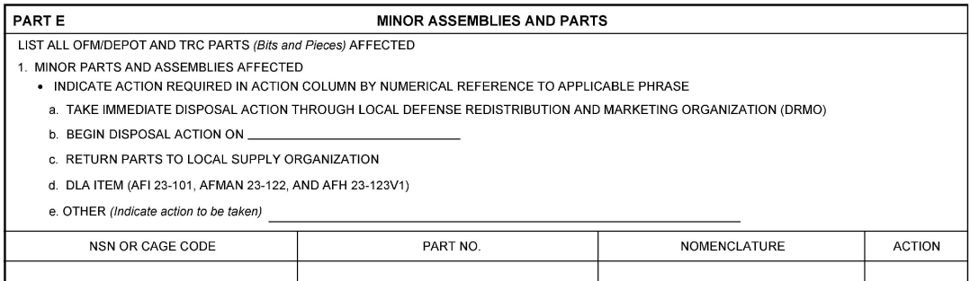
AFTO FORM 874 Part E - Minor Assemblies and Parts
Block 1 – Minor Parts and Assemblies Affected: List all required information in the applicable column. Indicate action required for minor parts and assemblies in the Action column with reference to the applicable phrase from 1a through 1e. For item 1a, list minor parts and assemblies to be returned to DRMO with disposal action. For item 1b, select the disposal action date from the dropdown calendar. For item 1d, follow the guidance provided by AFI 23-101, AFMAN 23-122, and AFH 23-123V1. If 1e is utilized, enter any other action to be taken.

Slide 17
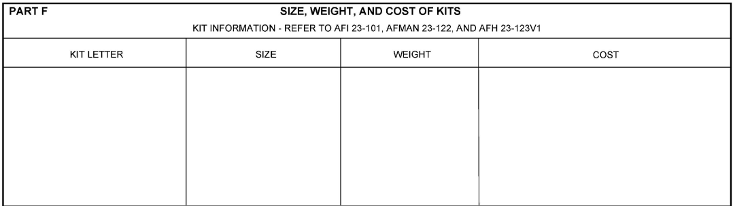
AFTO FORM 874 Part F - Size, Weight and Cost of Kits
List all required kit information in the applicable column (if known).
Refer to AFI 23-101, AFMAN 23-122, and AFH 23-123V1.

Slide 18
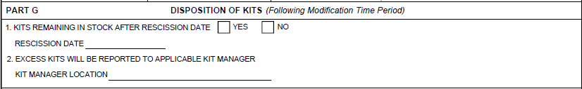
AFTO FORM 874 Part G - Disposition of Kits
Block 1 – Kits remaining in stock after rescission date: Check the applicable box “YES” or “NO” to indicate whether kits remain in stock after the rescission date. Select the rescission date from the dropdown calendar.
Block 2 – Excess kits will be reported to applicable kit manager: Enter the location of the applicable kit manager.

Slide 19
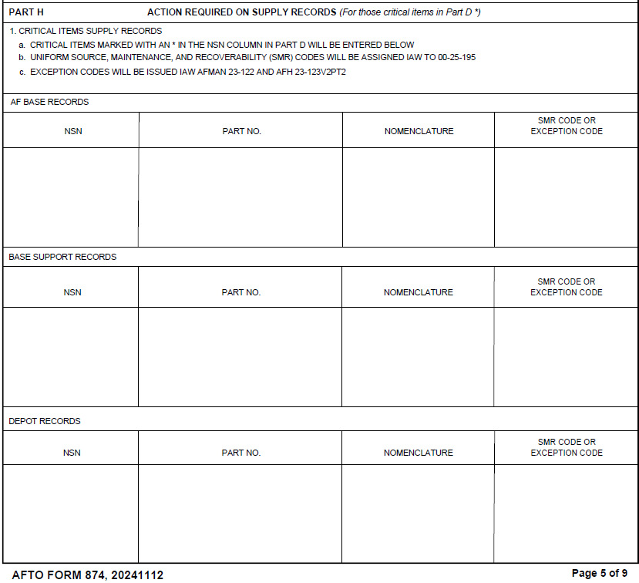
AFTO FORM 874 Part H - Action Required On Supply Records
Block 1 – Critical Items Supply Records: List all required part information for those critical items identified by and * in part D, NSN column. Fill out applicable table for AF Base Records, Base Supports Records, and Depot Records. Enter SMR Code IAW TO-00-25-195 or Exception Code IAW AFMAN 21-122 and AFH 23-123V2PT2.

Slide 20
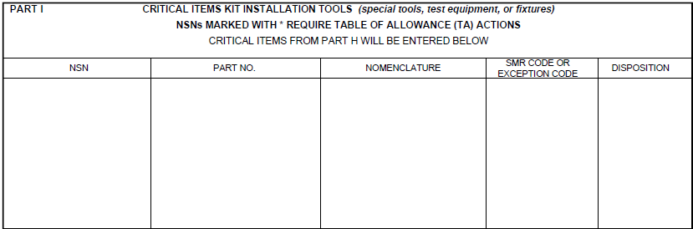
AFTO FORM 874 Part H - Action Required On Supply Records
Part I – List all required information in the applicable column for critical items kit installations tools (special tools, test equipment, or fixtures). Enter the disposition instructions for each item listed. Provide instructions for disposal after completion of the TCTO.

Slide 21
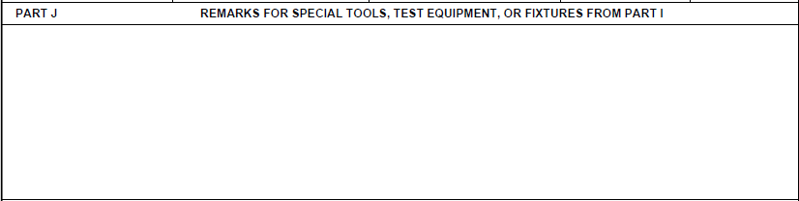
AFTO FORM 874 Part H - Action Required On Supply Records
Part J – Enter any remarks pertaining to all special tools, test equipment, or fixtures required for kit installations which are not available to the performing activity.

Slide 22
AFTO FORM 874
Part I, Kit Installation Tools.
List all special tools, test equipment or fixtures required for kit installation which are not normally available to the performing activity.
The method of obtaining special equipment will be listed in the source column, and the disposition column will provide instructions for disposal after completion of the TCTO.
NSN | Part Number | Nomenclature | Source | Disposition
XXXX-XX-XXX-XXXX | XXXXXXX | XXXXXXXXX | AF, DLA, Contractor | DeMil, etc.

Slide 23
AFTO FORM 874
Part J, Remarks.
Used for any carry-over information (indicate which part/block is being carried over) and to provide further explanation of TCTO requirements.

Slide 24
AFTO FORM 874 Part K - Certification
Block 1 – Equipment Specialist: Enter the equipment specialists name, office symbol, and phone number.
Block 2 – Equipment Specialist signature: Enter the equipment specialist's electronic signature. Once digitally signed, data will auto-populate.
Block 3 – Kit Manager: Enter the kit manager’s name, office symbol, and phone number.
Block 4 – Kit Manager Signature: Enter the kit manager’s electronic signature. Once digitally signed, date will auto-populate.
Block 5 – Program Manager (PM) approval: Enter the approving program manager’s name, office symbol, and phone number.
Block 6 – Program Manager (PM) signature: Enter the approving program manager’s electronic signature. Once digitally signed, date will auto-populate.
Block 7 – Production Management Specialist (or equivalent): Enter the production management specialist’s name, office symbol, and phone number.
Block 8 – Production Management Specialist signature (or equivalent): Enter the production management specialist’s electronic signature. Once digitally signed, date will auto-populate.
Block 9 – Engineer: Enter the engineer’s name, office symbol, and phone number.
Block 10 – Engineer signature: Enter the engineer’s electronic signature. Once digitally signed, date will auto-populate.
Block 11 – Contractor (if applicable): If applicable, enter the contractors name, date, and phone number.

Slide 25
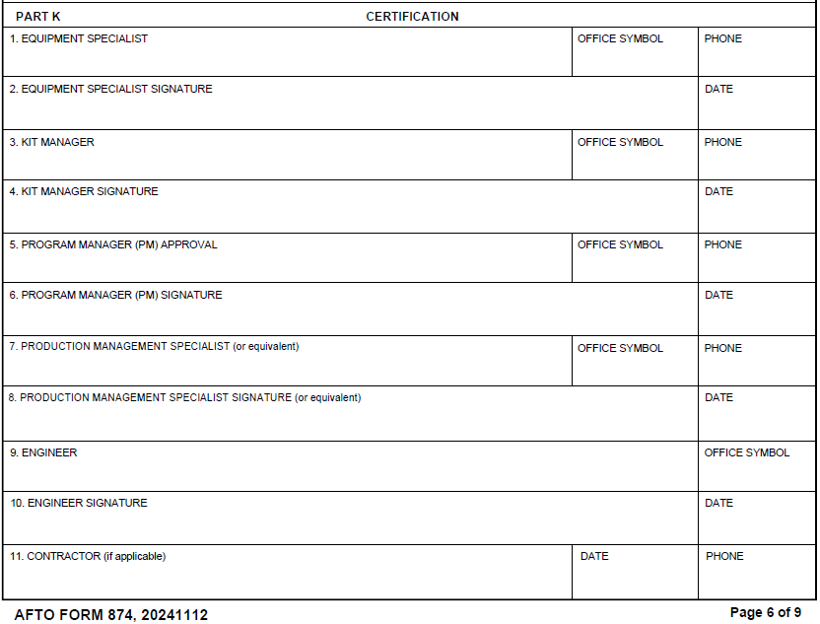
AFTO FORM 874 Part K - Certification

Slide 26
Part A
Qty. | NSN | Part Number | Nomenclature | Source | Code
A | xxxx-xx-xxx-xxxx | xxxxxxxx | Kit | AF, DLA, Contractor | See 9.
1 | xxxx-xx-xxx-xxxx | xxxxxxxx | xxxxxxxxxxx | AF, DLA, Contractor | See 9.
Back

Slide 27
AFTO FORM 874
Questions
Contact Bill Malone

